Slide 1
WEB PROJECT
PROPOSAL
Dan Trinh
Michelle Lee
Varen Thai
Joseph Grady
Joseph Loera
Notes:
Hello, today group 6 will introduce our web application.

Slide 2

OUR WEBSITE
Join us at Club Sticker with loud stickers that speak to your wallet. Once you drink the Kool-aid, you’ll be wanting to add more to your tab.
Club Sticker is a website that features many stickers all at a low price. Logged in users may contribute to the club by adding their own uploaded artwork and even get paid for it!
Notes:
Our website is called Club Sticker where you are able to view and purchase various stickers. The concept is similar to RedBubble except we exclusively sell stickers. Users upload their artwork where it will be featured on the website and other users would be able to purchase them, if we had a functional shopping cart. Disclaimer, we don’t have a shopping cart because we’re more focused on the security side and less on the actual web application.
[Show sticker catalog page] Here’s a quick look at our home page which is also the sticker catalog where you can view and purchase stickers.

Slide 3
Michelle Lee
USER AUTHENTICATION
Notes:
I’ll be talking about user authentication, going over the registration and login process, talking about input sanitization, password hashing, and protected pages.

Slide 4
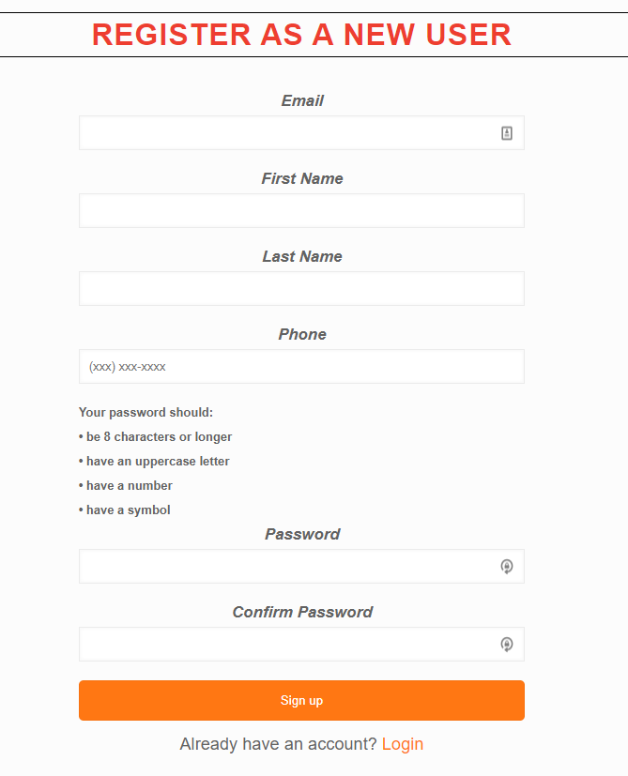
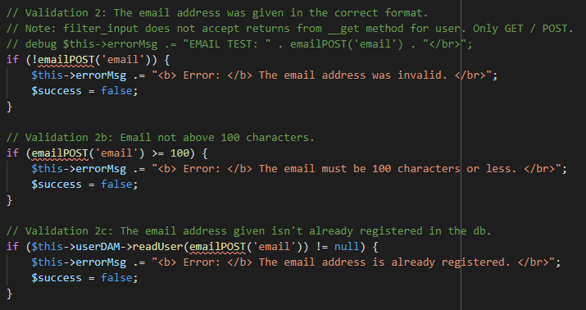
Registration - Email
part of RegisterVM::validateUserInput
validations
Notes:
Our registration page has 6 different fields. The first field is the email. The if statements checks whether the email is valid, if it’s 100 characters or less, and if it’s already in the database.

Slide 5
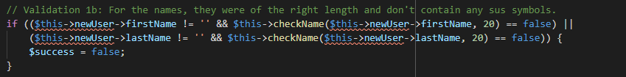
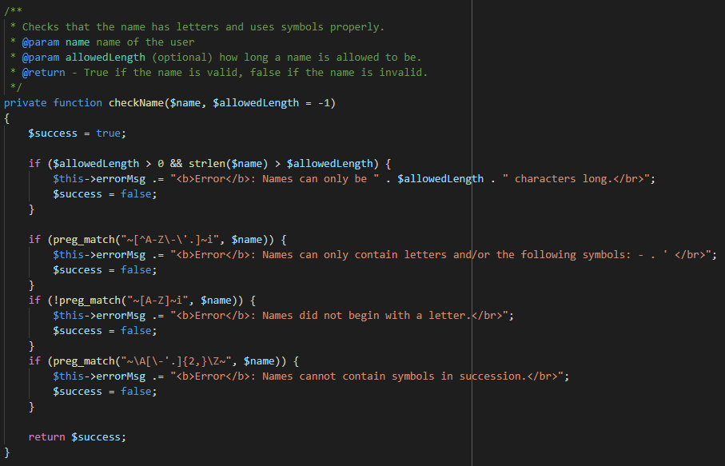
Registration - First & Last Name
part of RegisterVM::validateUserInput
RegisterVM::checkName
validations
Notes:
The second and third field are the first name and last name. The top snippet calls checkName() where the first name and last name are inputs, both capped at 20 characters.
The bottom snippet shows all the validations. We require the name to only have letters, with the exception of a hyphen, period, and quotation mark, that it begins with a letter, and checks for consecutive special characters.

Slide 6
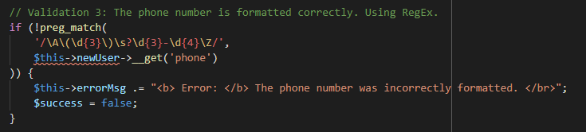
Registration - Phone Number
part of RegisterVM::validateUserInput
(323)
123
- 4567
Notes:
The fourth field is the phone number. We require that the user type in a parentheses and a hyphen. Everything else are digit numbers.

Slide 7
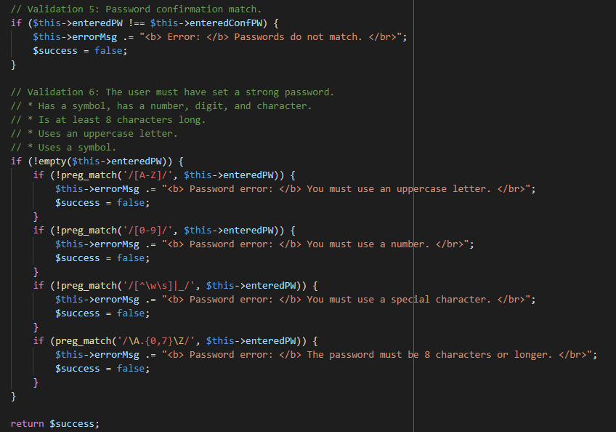
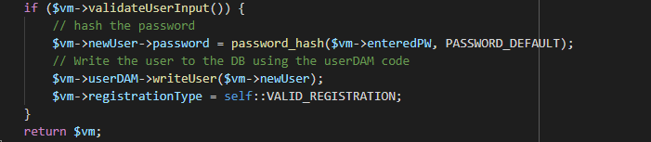
Registration - Password
part of RegisterVM::validateUserInput
validations
part of RegisterVM::getInstance
Notes:
The last 2 fields are for the password. The if statements requires that you use an uppercase letter, at least one number, at least one special character, and is at least 8 characters long.
If everything is valid, the password gets hashed and written into the db.
[Demo registration process] Now let me quickly demo the registration process and show you the hashed pw.

Slide 8
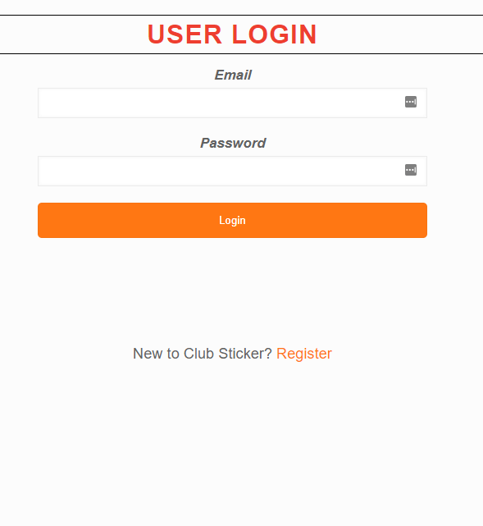
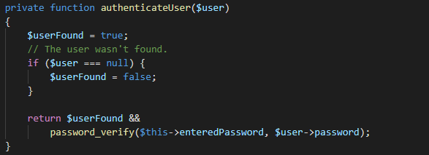
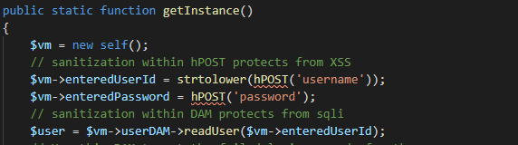
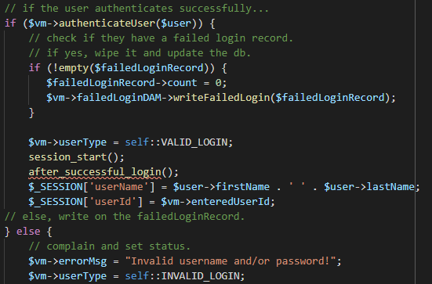
Login
part of LoginVM::getInstance
LoginVM::authenticateUser
part of LoginVM::getInstance
Notes:
Moving onto the login page. For our group, we created a view model specifically for the login portion.
[1st Arrow] When the user tries to login, the id input is compared with the db using the readUser method.
[2nd and 3rd Arrow] If there is a user in the db, it goes to authenticateUser() where the password input is compared with the db hashed password, using the password_verify method. If the input pw and hashed pw is a match...
[4th Arrow] then the login gets authenticated and the session starts.

Slide 9
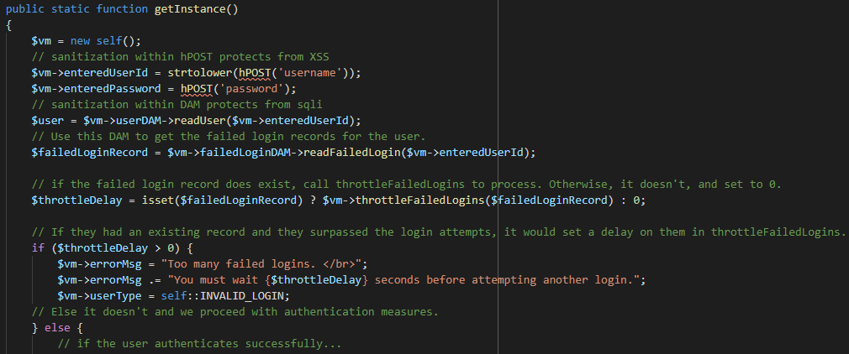
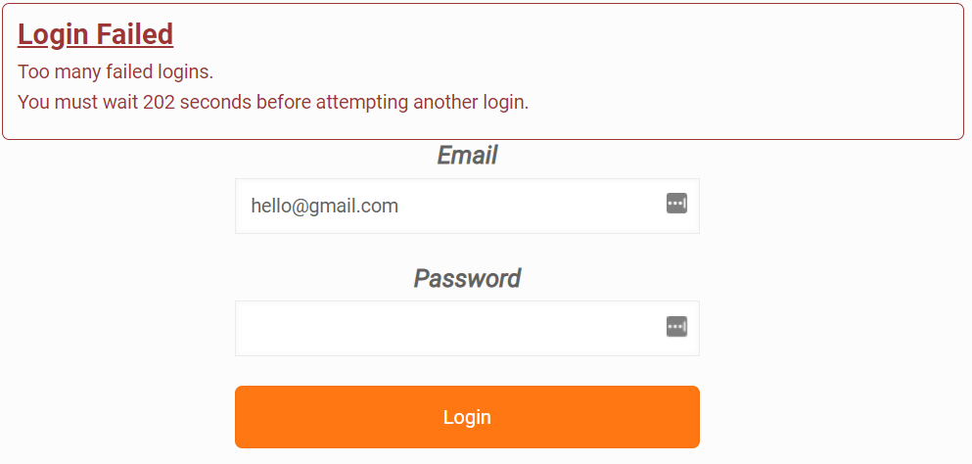
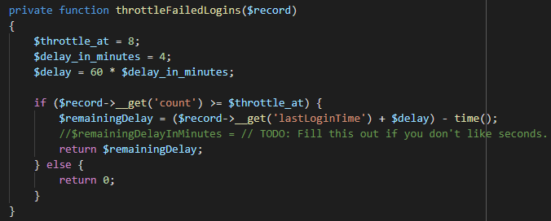
Login - Throttling
LoginVM::getInstance
LoginVM::throttleFailedLogins($record)
Notes:
In the getInstance() of our LoginVM we added additional code to throttle the user for failed login attempts. If there’s a failed record, and the user logs in with correct credentials, it will time out the user.
[1st Arrow] For every failed login, it gets updated into the db with the userId that was attempted.
[2nd Arrow] If a failed login associated with the userId exists, then the throttleDelay is set with the number of seconds the user will be timed out for.
[3rd Arrow] If a failed login exists and the user uses correct credentials to login, it will not let you login and the time out will appear like the image on the left.

Slide 10
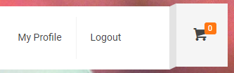
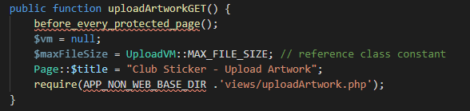
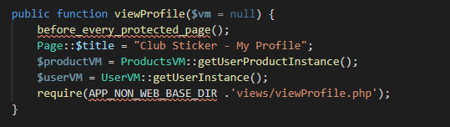
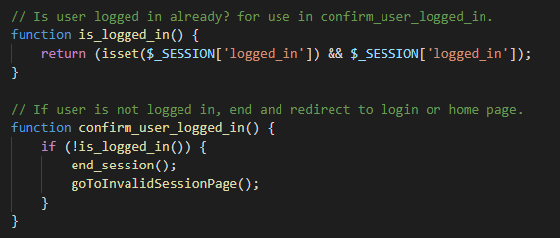
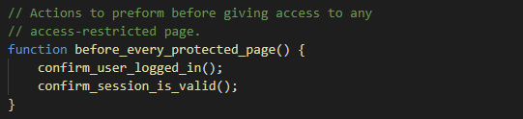
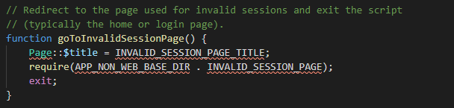
Authenticated User
After login
protected page
protected page
all from sessionFunctions()
Notes:
After logging in, you get access to the protected pages: “Upload Artwork” and “My Profile”.
[Arrows to before_every_protected_page] Each page uses the method before_every_protected_page() which checks if the user is authenticated and if the session is valid.
[Arrows to user_logged_in & session_is_valid] If either isn’t the case, then the user gets redirected to the login page.
[Demo login process + show protected pages (upload + profile)] Now I’ll demo the login and show the protected pages.
Now I’ll hand it off to Varen.

Slide 11
Varen Thai
SESSION HIJACKS

Slide 12
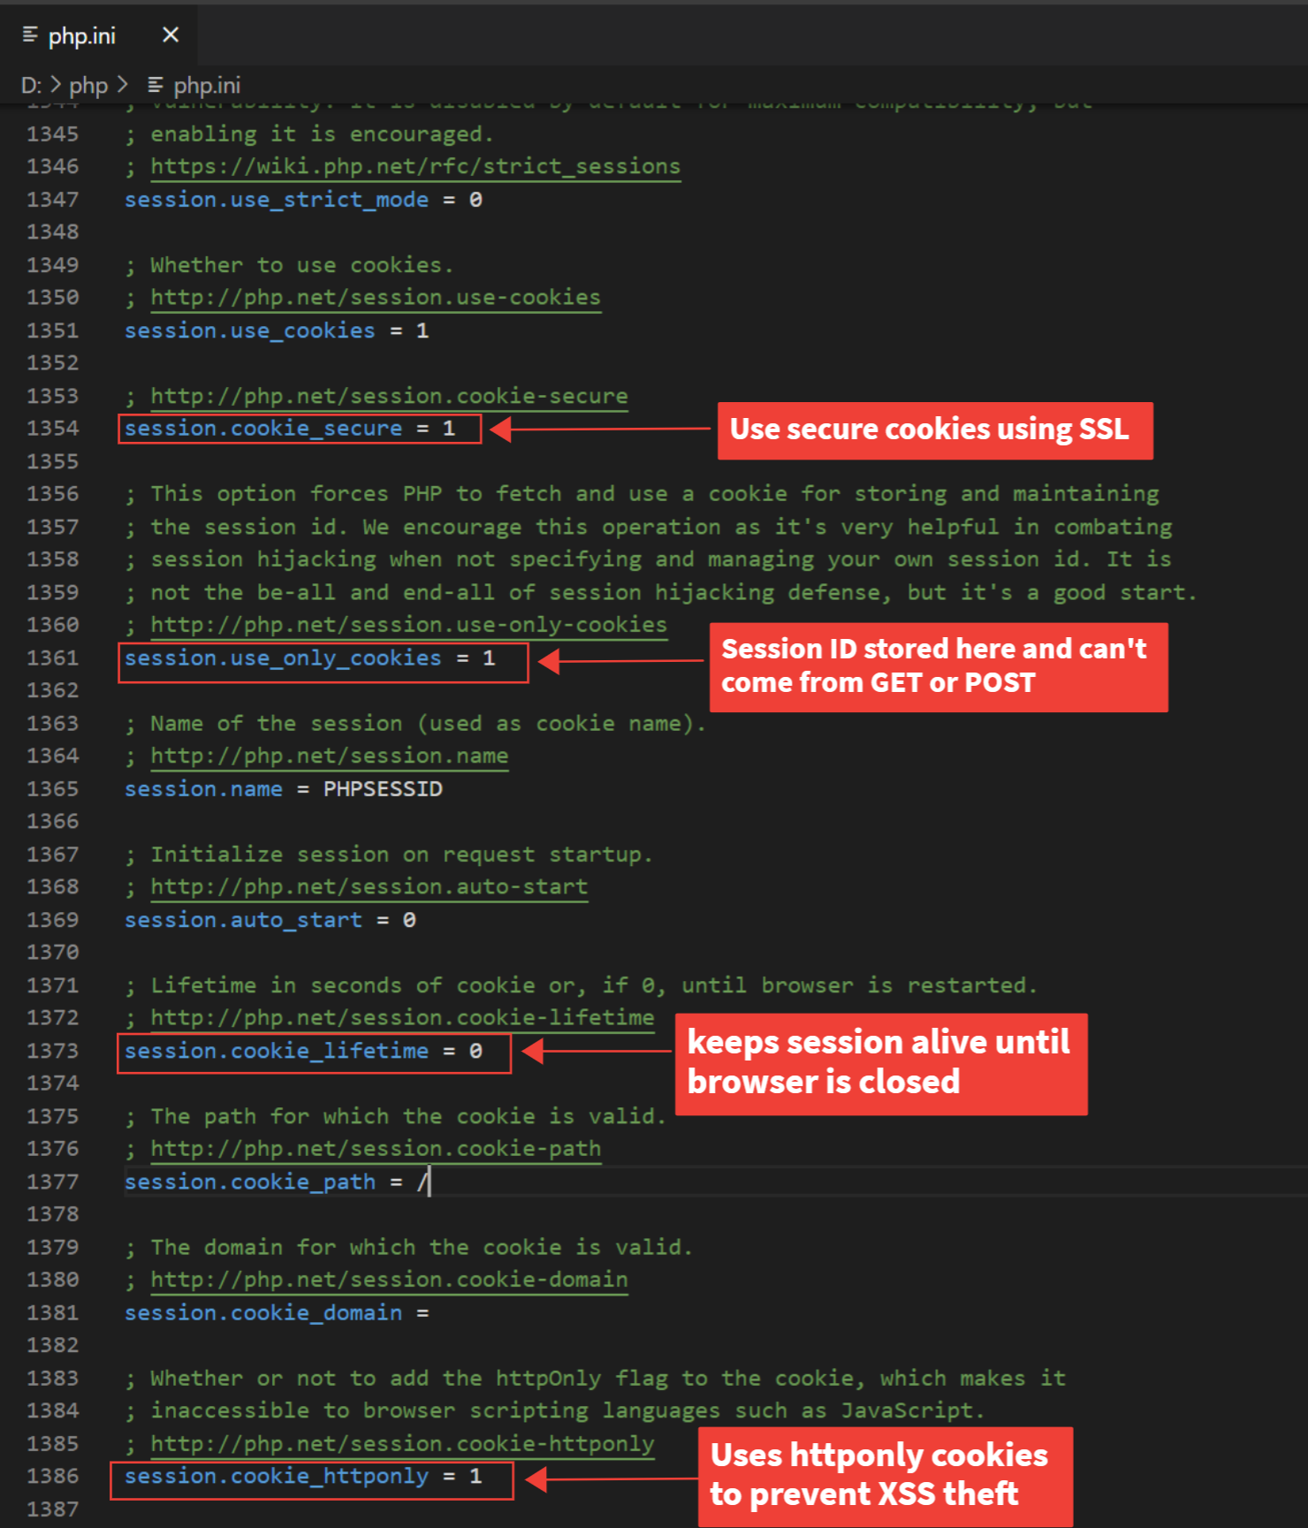
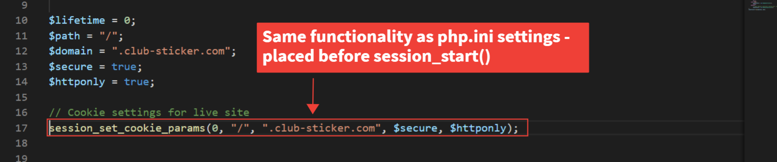
php.ini from PHP folder
php.ini settings to protect against session hijacking/fixation
session_set_cookie_params() used for live site

Slide 13
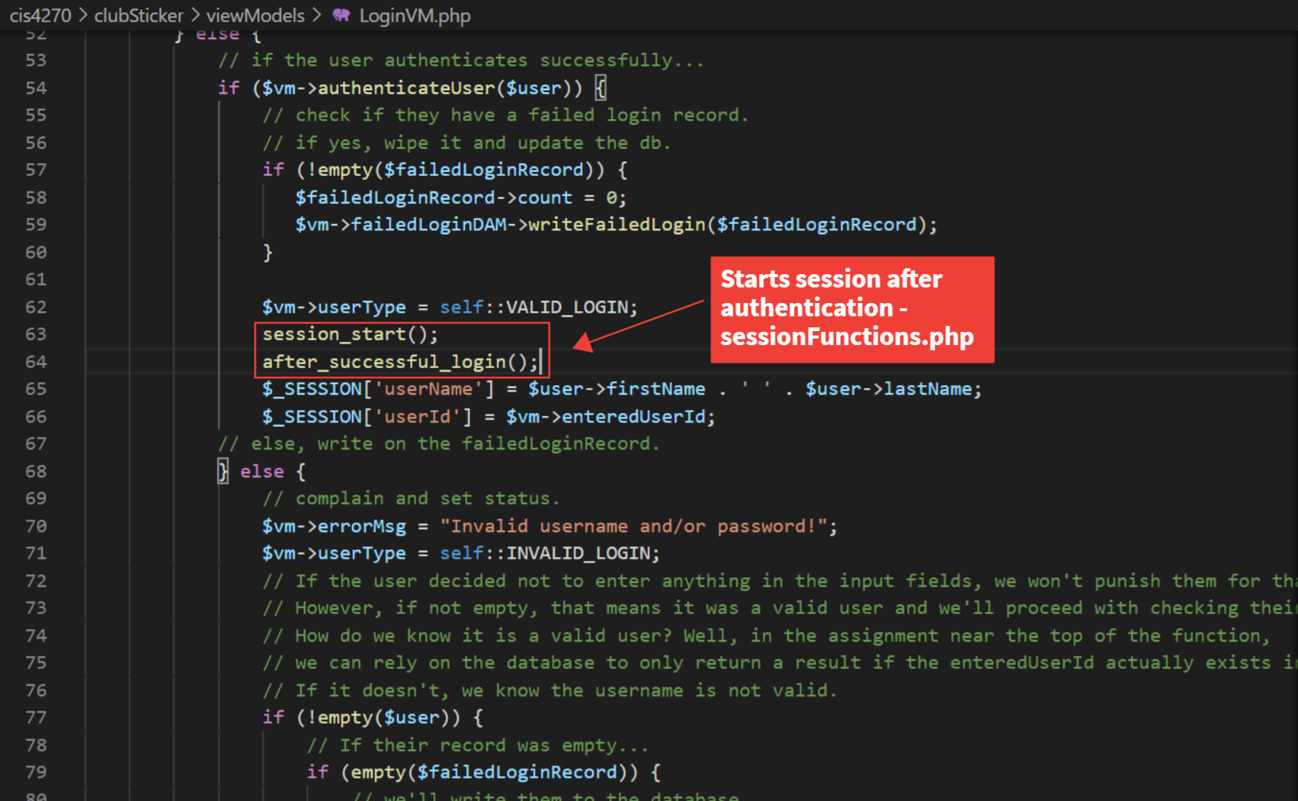
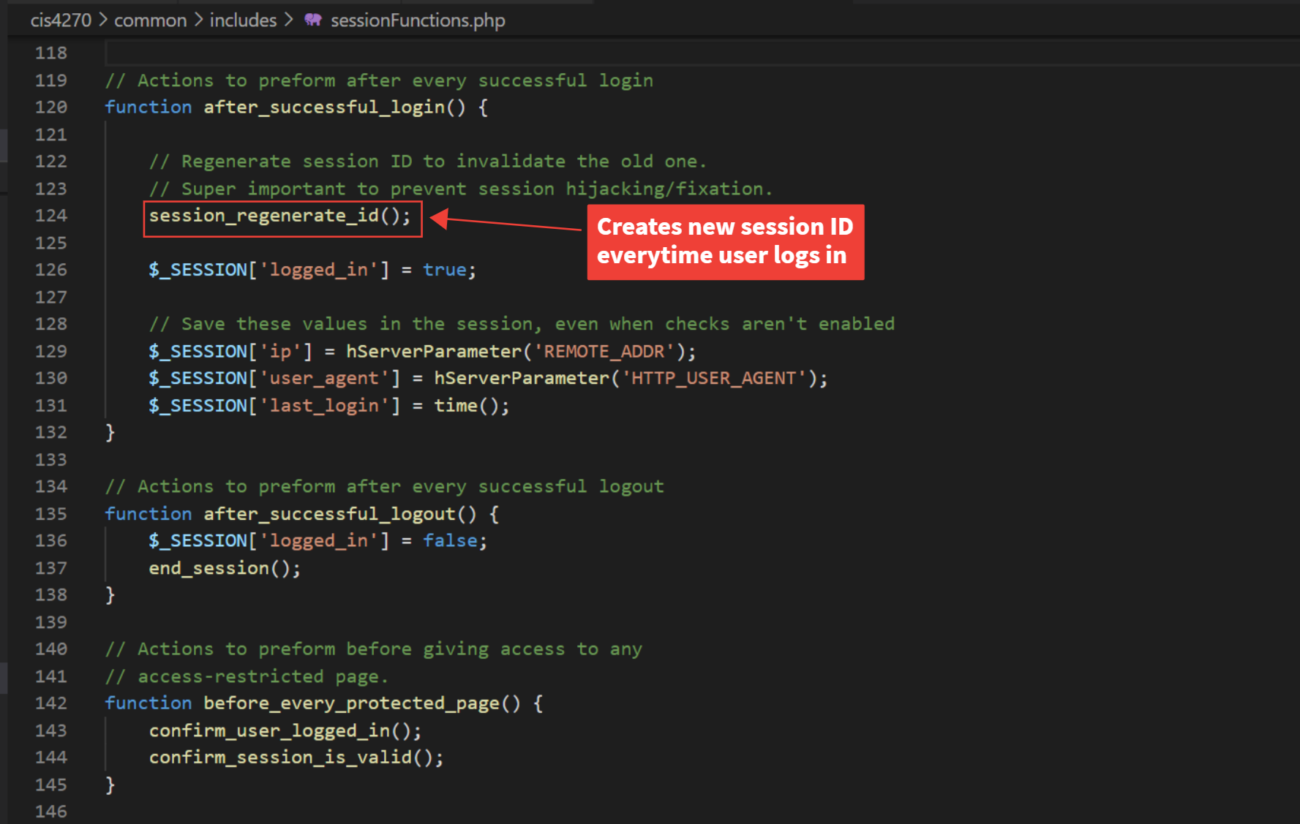
Login Protections

Slide 14
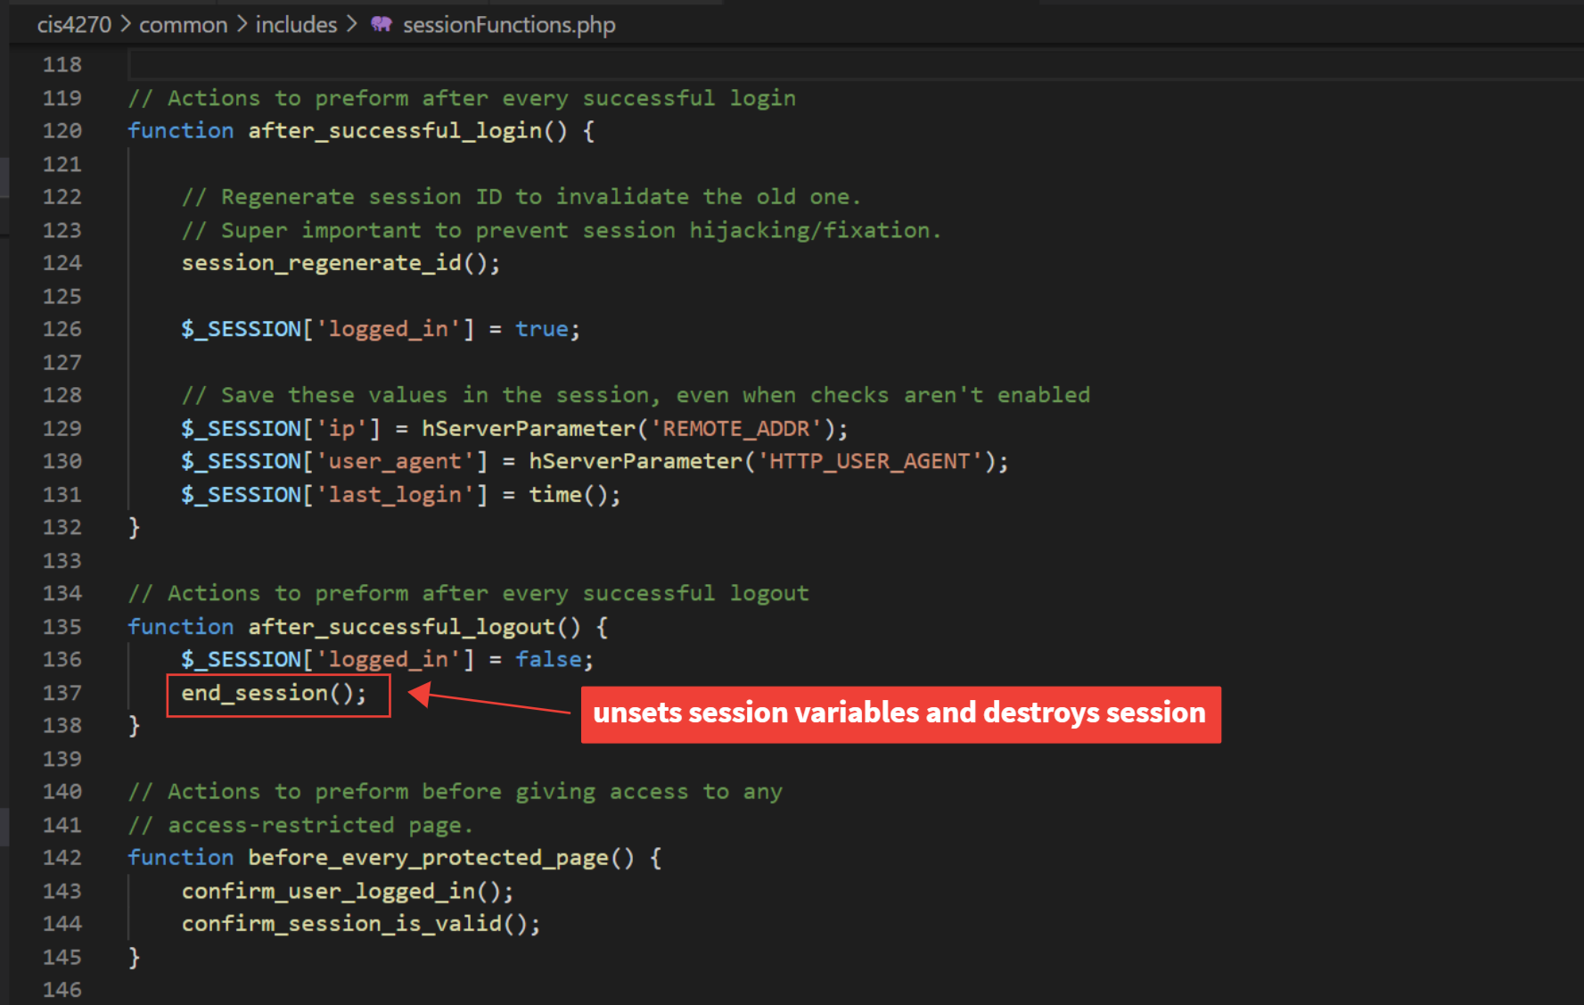
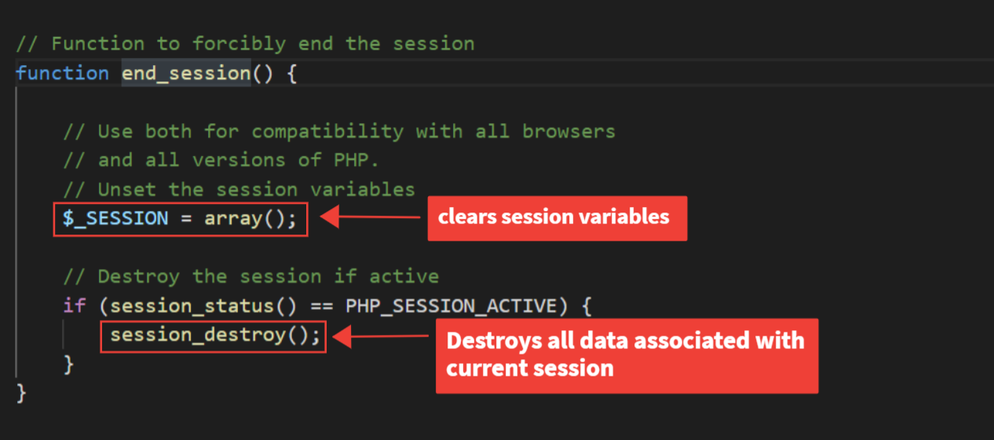
Logout Function

Slide 15
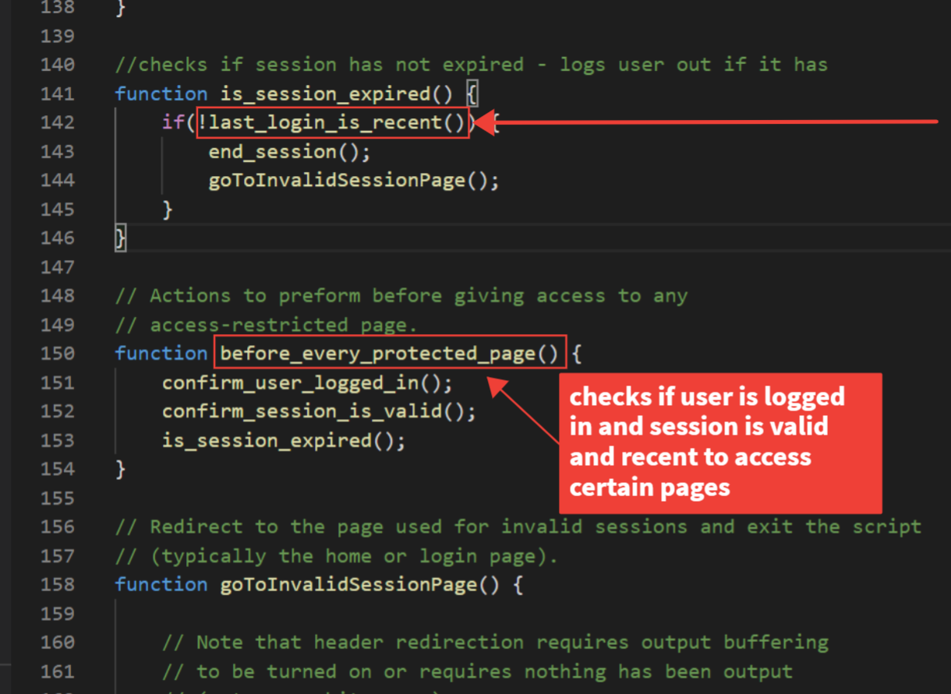
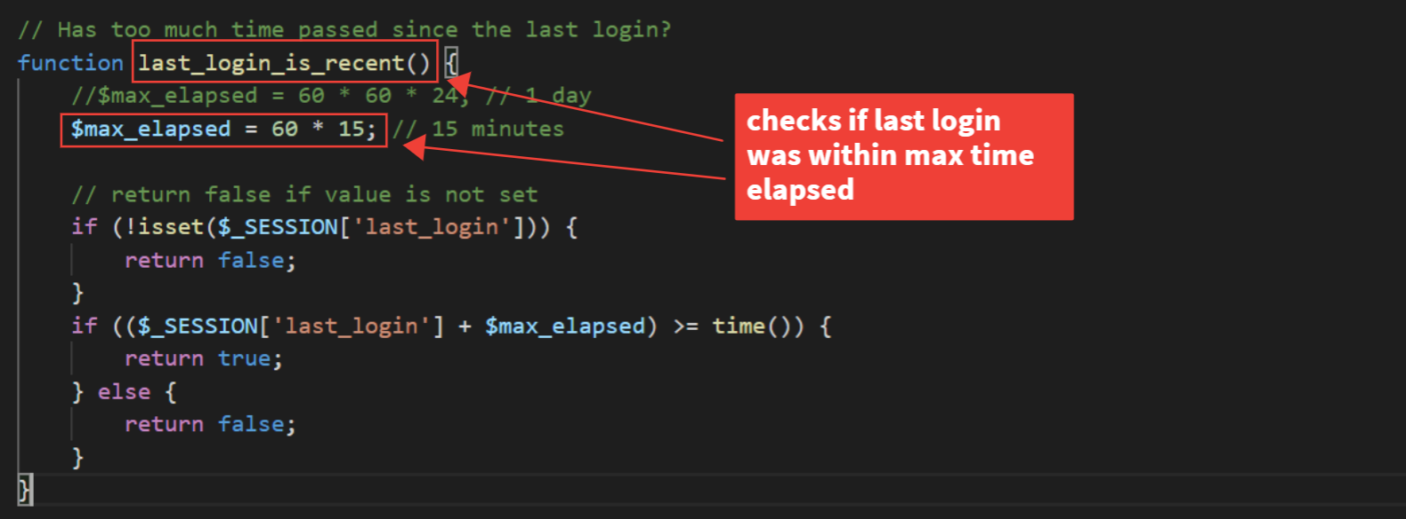
Logout User after Session Timeout

Slide 16
Joseph Loera
SQL INJECTIONS

Slide 17
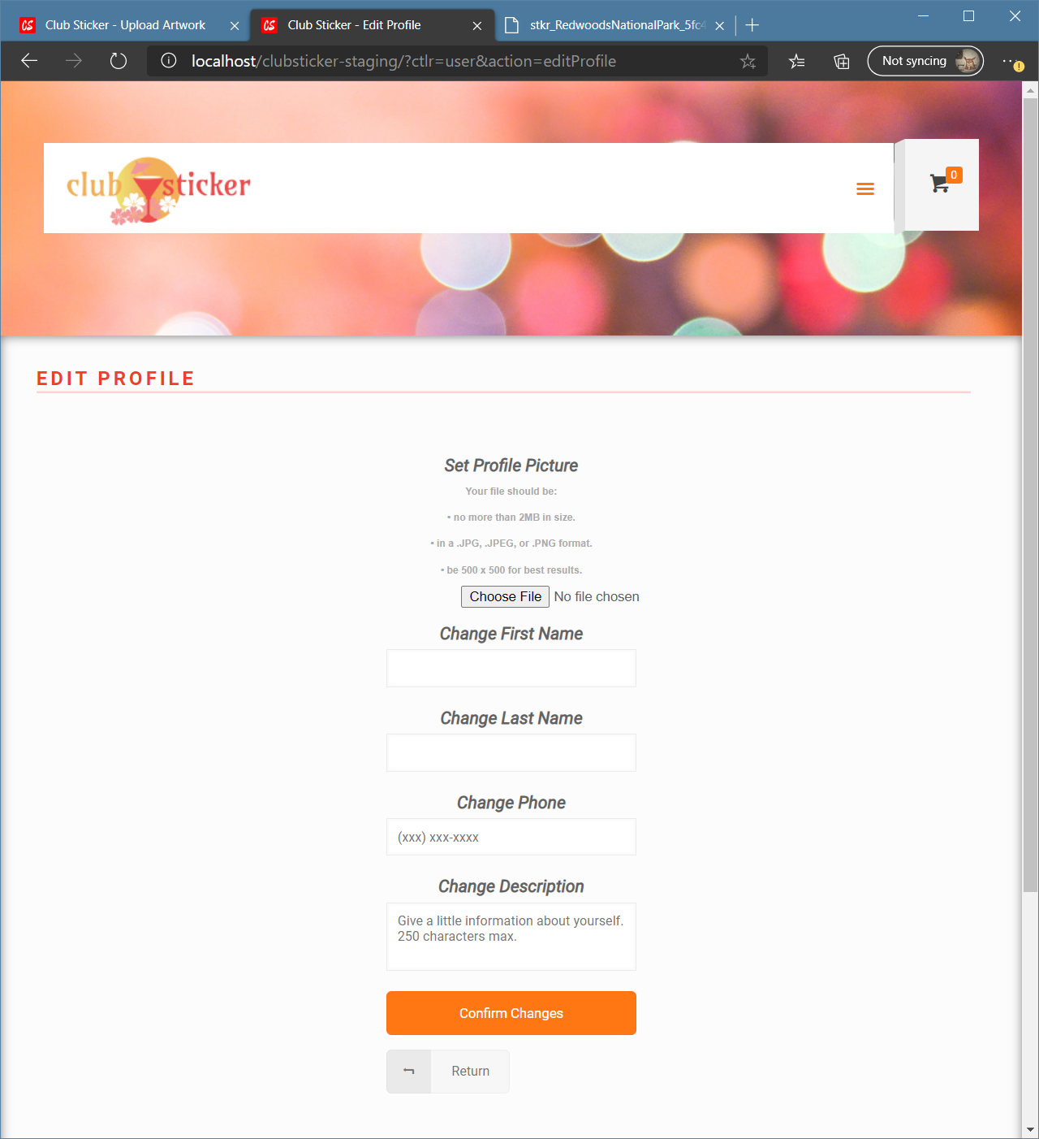
Edit Profile and SQLI attacks
Users can edit their profiles after logging in.
An attacker might decide to use these fields here to execute SQLI attacks, damaging our database.
What provisions have we made to defend against the attacks?
Limit application privileges
Run prepared statements natively
Regex validations
Prepared statements

Slide 18
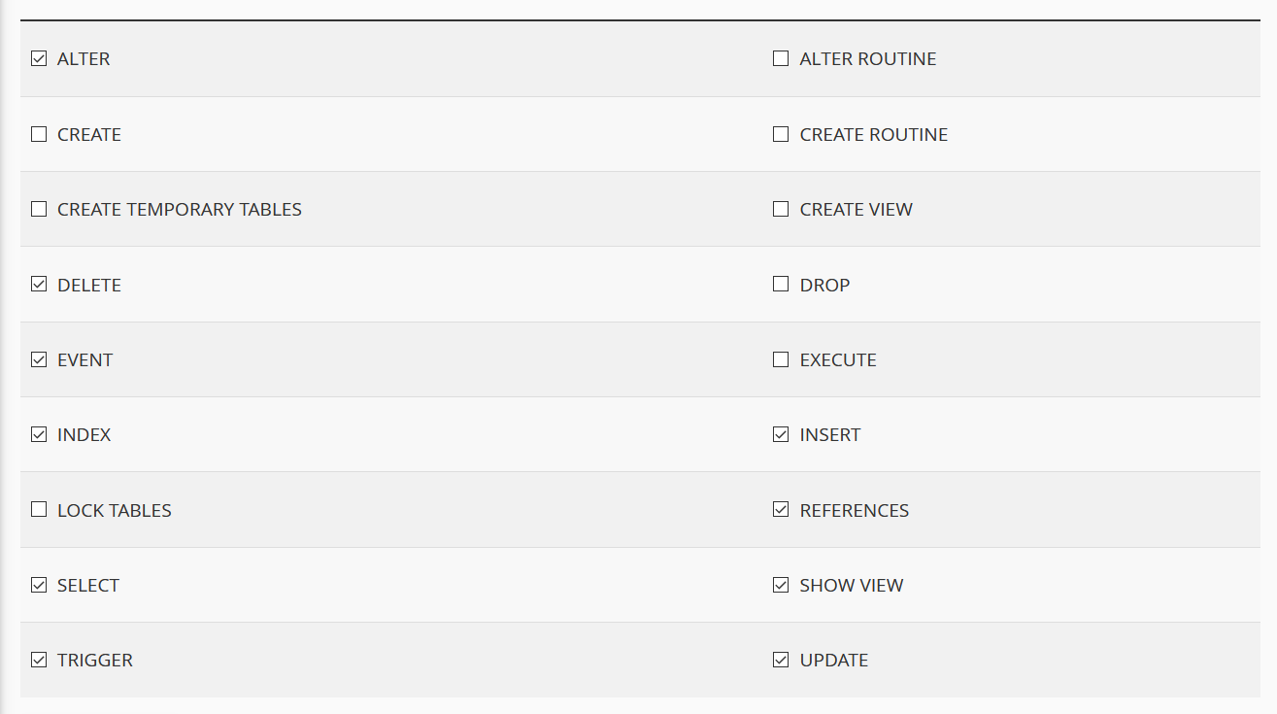
Account Permissions
SQLI attacks aren’t stopped through this, but they are limited because some permissions are disabled, such as:
Creating tables/databases
Viewing tables/databases
Dropping tables/databases
Executing procedures and routines

Slide 19
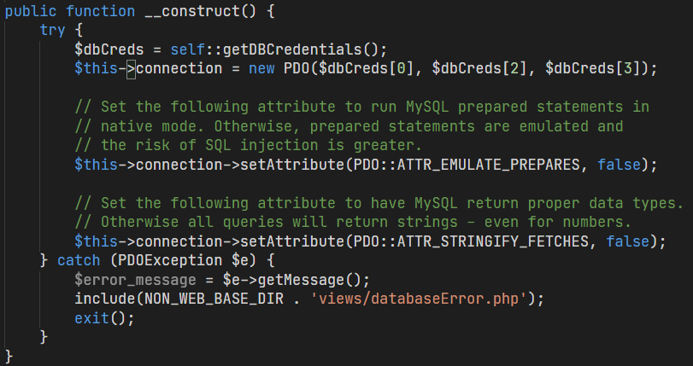
DBAccess
Forces prepared statements to run in native mode.

Slide 20
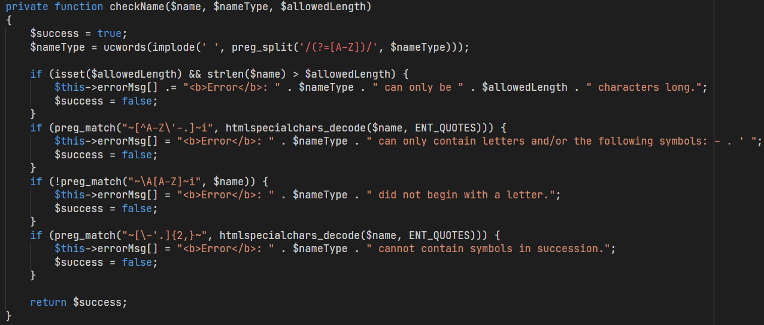
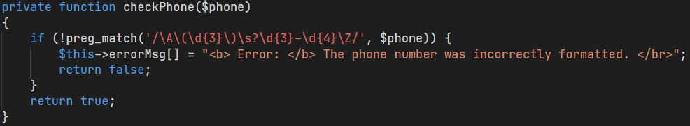
Regex Validation
Some input fields, like name or phone, are protected via Regex validations.
These prevent symbols that are common in SQLI attacks.
limits characters to an allowed length
Disables symbols like semicolons and hashtags.
cannot contain symbols in succession, disabling “--” (i.e. comment symbol)
Phone verification only allows strings as (xxx) xxx-xxxx

Slide 21
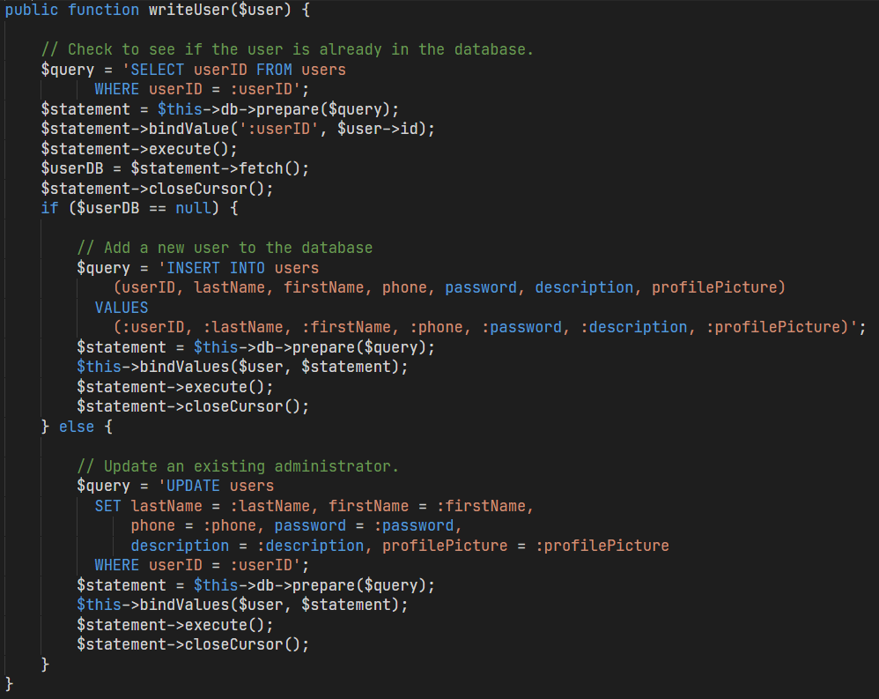
MOST IMPORTANT: Prepared Statement
Use of prepared statement

Slide 22
Joseph Grady
XSS SCRIPTING

Slide 23
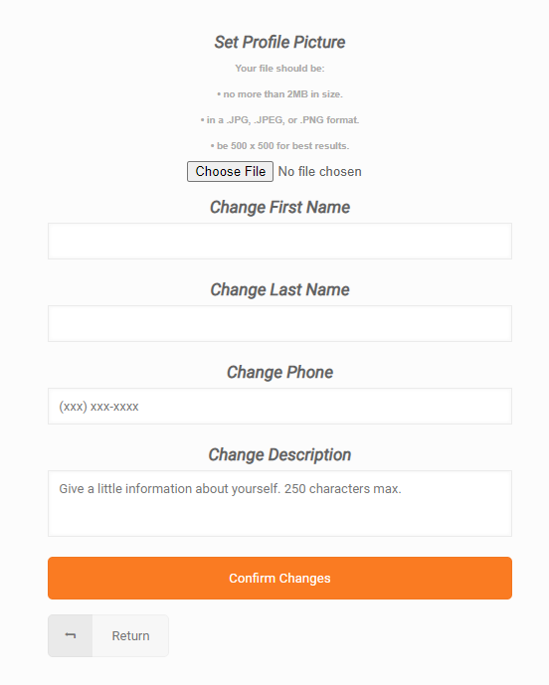
Edit Profile
Pages like Edit Profile, Registration, and Upload Artwork are vulnerable to cross-site scripting (XSS), and require sanitizing data to prevent it from happening.
In particular, our website uses validationFunctions to call upon functions such as hGET and hPOST to sanitize data.

Slide 24
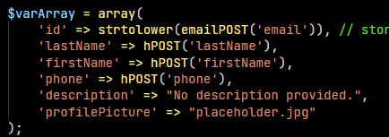
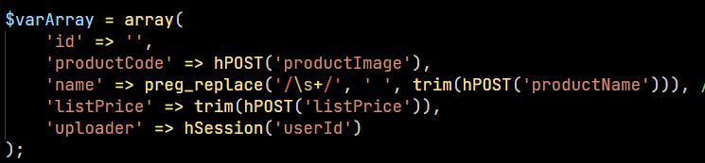
RegisterVM/UploadVM
From RegisterVM
hPOST() is used in RegisterVM and UploadVM in order to sanitize the data within their forms.
From UploadVM

Slide 25
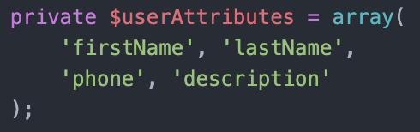
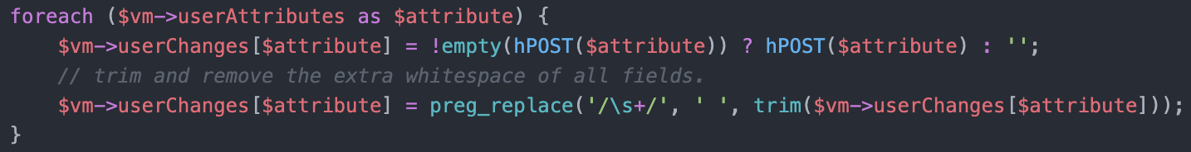
EditProfileVM
hPOST() is used in EditProfileVM too in order to sanitize the text fields within its forms.

Slide 26
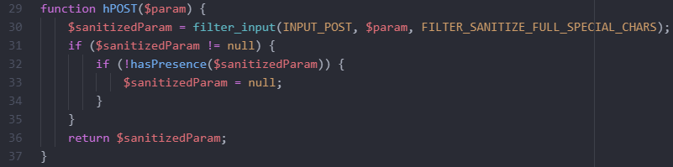
function hPOST
function calls on filter_input
looks for POST input (and only POST)
We use hPOST to sanitize POST requests in order to prevent XSS attacks from text forms.
this is the equivalent of htmlspecialchars() function, which converts special characters into HTML entities (for example, "&" becomes "&amp;")

Slide 27
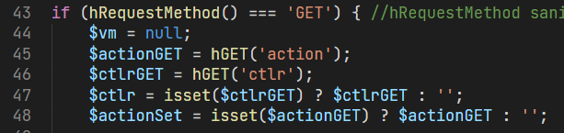
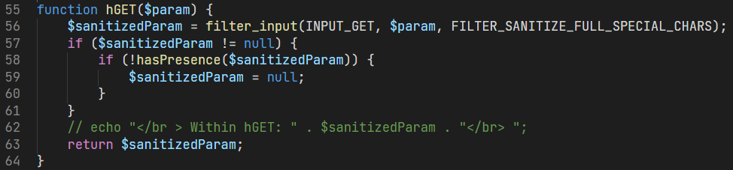
function hGET
We sanitize GET requests too in the request broker, to prevent XSS attacks through URL.
looks for GET input (and only GET)
function calls on filter_input
this is the equivalent of htmlspecialchars() function, which converts special characters into HTML entities (for example, "&" becomes "&amp;")

Slide 28
Dan Trinh
FILE UPLOAD ABUSE

Slide 29
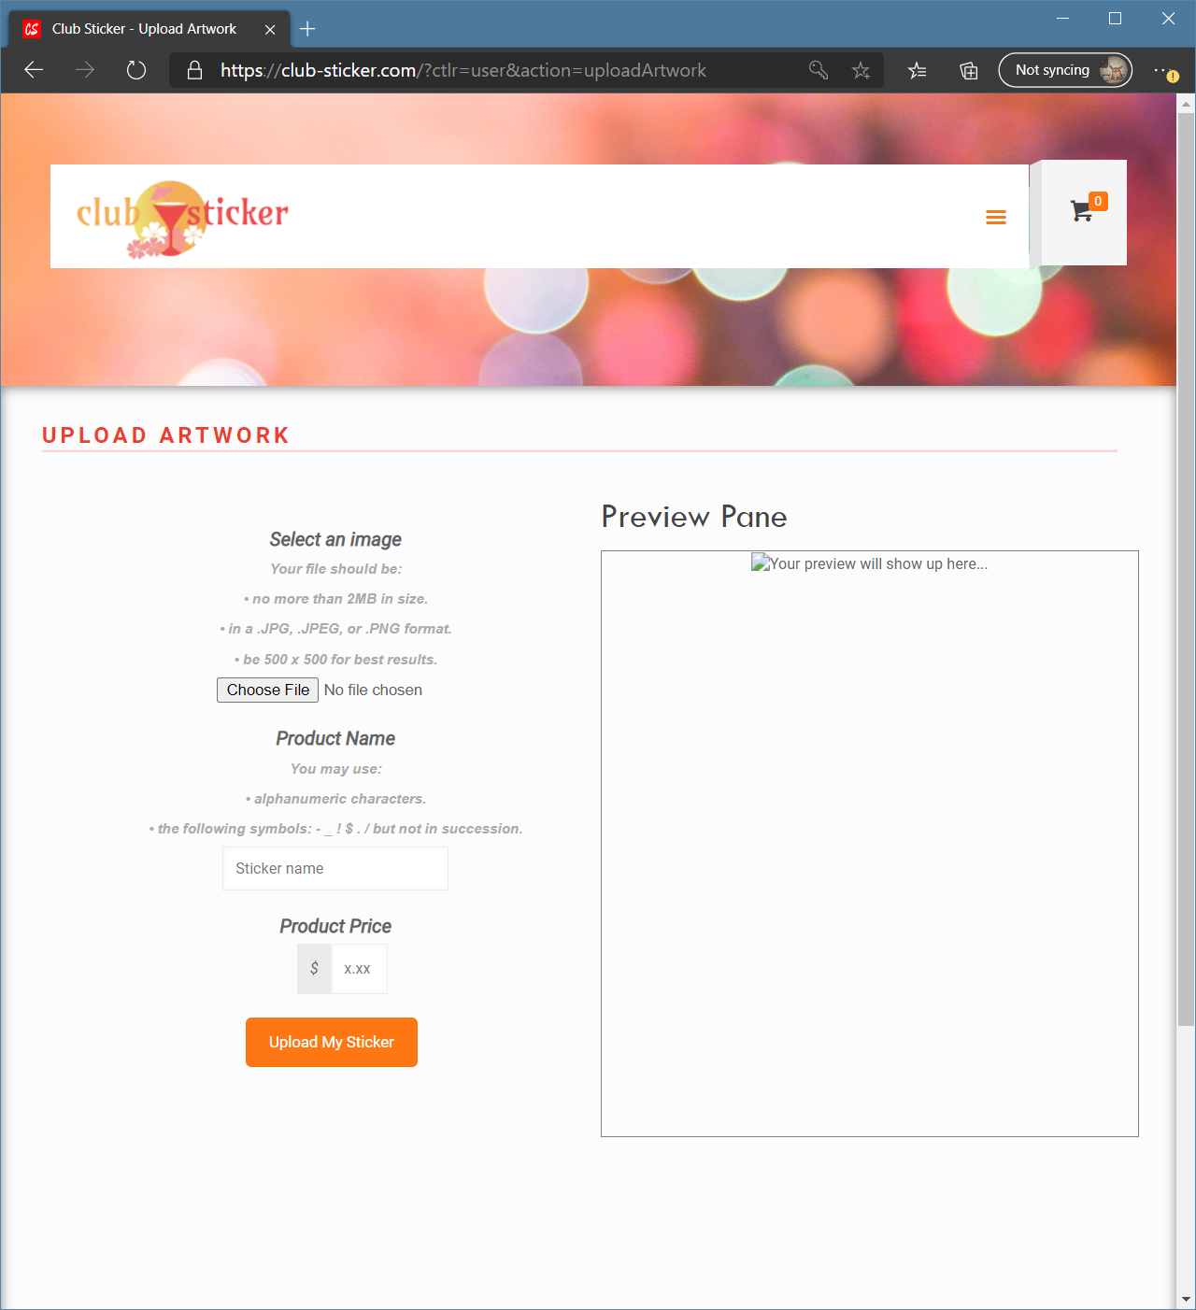
File Upload Defense \ Upload Artwork
Uploading artwork is essential to Club Sticker’s functionality.
Unfortunately, there are many ways to commit file upload abuse.
What sort of defenses have we included?
Notes:
Secure file upload (including file type checks, filename validation, and file validation). (and implicit requirements)

Slide 30
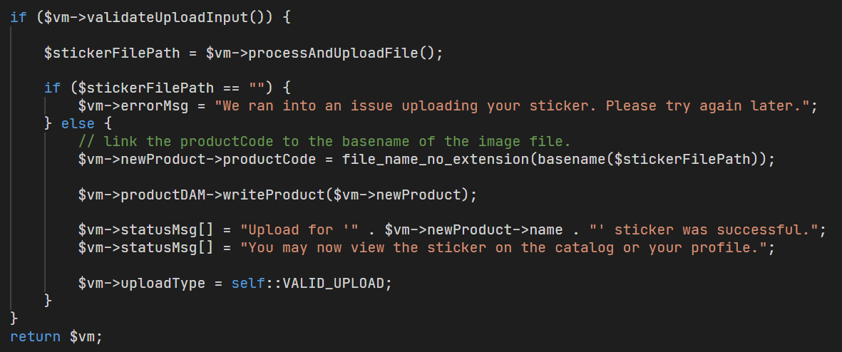
File Upload Defense \ UploadVM.php
From UploadVM::getInstance(), which contains logic for uploading artwork:
Must pass validation to return TRUE, before any file uploads are performed.
Notes:
Secure file upload (including file type checks, filename validation, and file validation). (and implicit requirements)

Slide 31
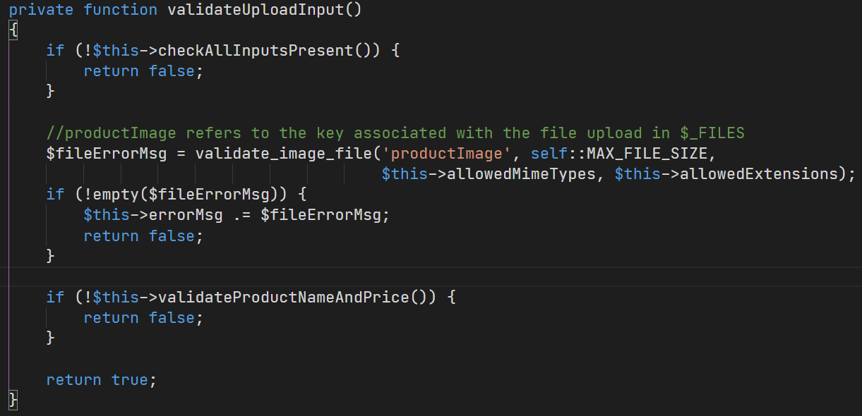
File Upload Defense \ validateUploadInput()
After being called in getInstance(), what happens in validateUploadInput()?
Precursor:
The user must have entered all inputs before we check the upload.
Notes:
Secure file upload (including file type checks, filename validation, and file validation). (and implicit requirements)

Slide 32
File Upload Defense \ validateUploadInput()
If all inputs are present, we call validate_image_file().
i.e. (_FILES[‘productImage’][])
validate_image_file() - Four arguments
Key referring to upload in _FILES.
Max file size.
MIME type whitelist.
File extension whitelist.
const MAX_FILE_SIZE = 1048576 * 2;
$allowedMimeTypes = ['image/png', 'image/jpg', 'image/jpeg'];
$allowedExtensions = ['png', 'jpg', 'jpeg'];
Notes:
So we do all of our work in this function.

Slide 33
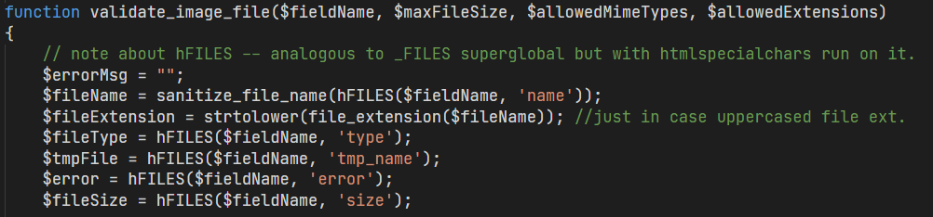
File Upload Defense \ validate_image_file() - Part 1
In validate_image_file(), we begin by assigning the variables:
Assignment based on _FILES[$fieldName] superglobal.
We access this superglobal through hFILES(); which sanitizes all values.
Additional sanitization using Regex to sanitize the given filename.
Sanitize uploaded file name using Regex replace
([^A-Za-z0-9_\-\.]|[\.]{2})
No non-alphanumeric characters or symbols that aren’t ‘_’, ‘-’, ‘.’ (‘..’ not allowed)

Slide 34
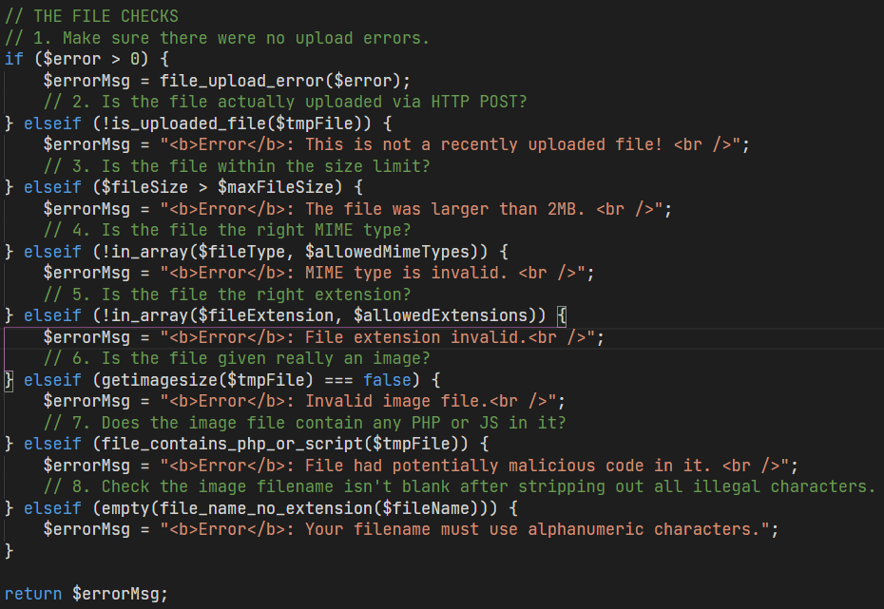
File Upload Defense \ validate_image_file() - Part 2
Now we can run a series of checks on the uploaded file.
It must return FALSE for ALL of these checks.
1. $error > 0
PHP ran into issues uploading the file to temp dir.
2. !is_uploaded_file($tmpFile)
The file wasn’t uploaded via HTTP POST.
3. $fileSize > $maxFileSize
The file size is LARGER than max file size (2mb).
4. !in_array($fileType, $allowedMimeTypes)
The file type is not in the MIME extension whitelist.
Notes:
Now we can run a series of checks on the uploaded file.
Since the if-elseif branch is so extensive, I figure it would a better idea to break it down on the left here rather than annotating it directly.
Now I’m going to break down the 8 checks into two slides here.
So, the first four are:
uploading to a temporary directory.

Slide 35
File Upload Defense \ validate_image_file() - Part 3
The last four conditions to check are FALSE:
5.!in_array($fileExtension,$allowedExtensions)
The file type is NOT in the file extension whitelist.
6. getimagesize($tmpFile) === false
The file is NOT really an image; it has no dimensions.
7. file_contains_php_or_script($tmpFile)
The file contains a <?php or <script> tag.
8. empty(file_name_no_extension($fileName)
The file name (w/o extension) is empty after sanitizing it.
If any of these conditions are TRUE, an error message is returned!
Notes:
Now we can run a series of checks on the uploaded file.
Since the if-elseif branch is so extensive, I figure it would a better idea to break it down on the left here rather than annotating it directly.
Now I’m going to break down the 8 checks into two slides here.
So, the first four are:
uploading to a temporary directory.

Slide 36
File Upload Defense \ back to validateUploadInput()
If validate_image_file() passed all checks, there’s no error message.
If an error message was returned, output it to the user.
Return false and fail the validation.
Unrelated to file validation. Validates text fields in upload artwork form.
Notes:
“No news is good news”
That last one, don’t worry too much about it, it’s just validation for the name and price of the product which was a part of the upload artwork form.
ss

Slide 37
File Upload Defense \ back to getInstance
So we passed the test. We call processAndUploadFile() to actually upload it.
Notes:
Secure file upload (including file type checks, filename validation, and file validation). (and implicit requirements)

Slide 38
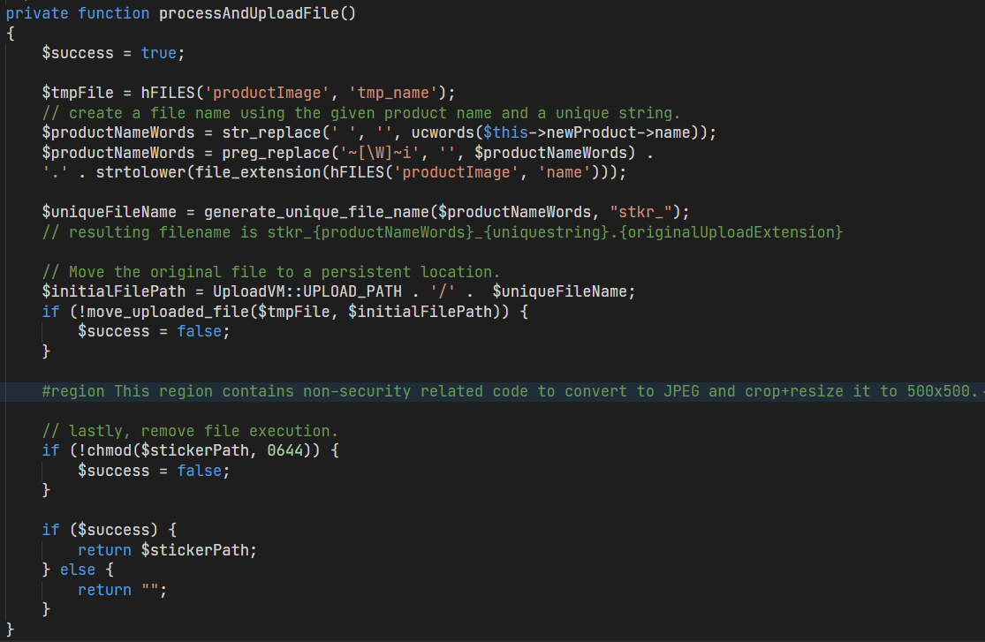
File Upload Defense \ processAndUploadFile()
Construct a new filename using the product name.
Only use alphanumeric characters the user entered.
generate_unique_file_name()
assembles a unique filename with our product name, uniqid(), and stkr_ prefix.
Use move_uploaded_file() to move the upload to our unique filepath on the public web directory.
Remove
execute
permissions.
If successful, return filepath, else “”.
Notes:
Now there’s some code in that folded region that contains logic on converting it to JPEG and resizing it to 500x500, but I’ve omitted since it’s not related to security.

Slide 39
File Upload Defense \ writing to DB in getInstance()
If no filepath returned, inform user there was an issue.
Else, assign the new image file name as the product code and write to database.
Notes:
Now there’s some code in that folded region that contains logic on converting it to JPEG and resizing it to 500x500, but I’ve omitted since it’s not related to security.

Slide 40
THANKS FOR LISTENING!
Hope to see you on Club Sticker soon!
Group 6

